Slide 1
High Performance and Distributed Computing for Big Data
Unit 3: Hands-On AWS Setup
Ferran Aran Domingo ferran.aran@udl.cat
Universitat Rovira i Virgili and Universitat de Lleida

Slide 2
Recap: Where are we now?

Slide 3
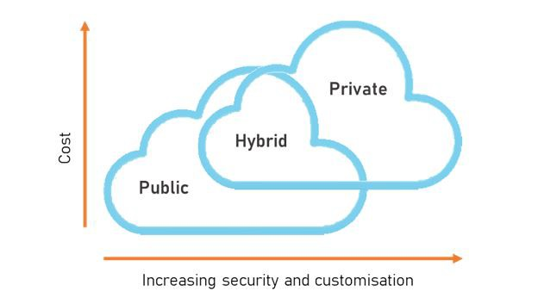
Public vs Private vs Hybrid
In the last sessions, we discussed the differences between public, private, and hybrid cloud models.
Figure 1: How cost and privacy grow with different cloud paradigms

Slide 4
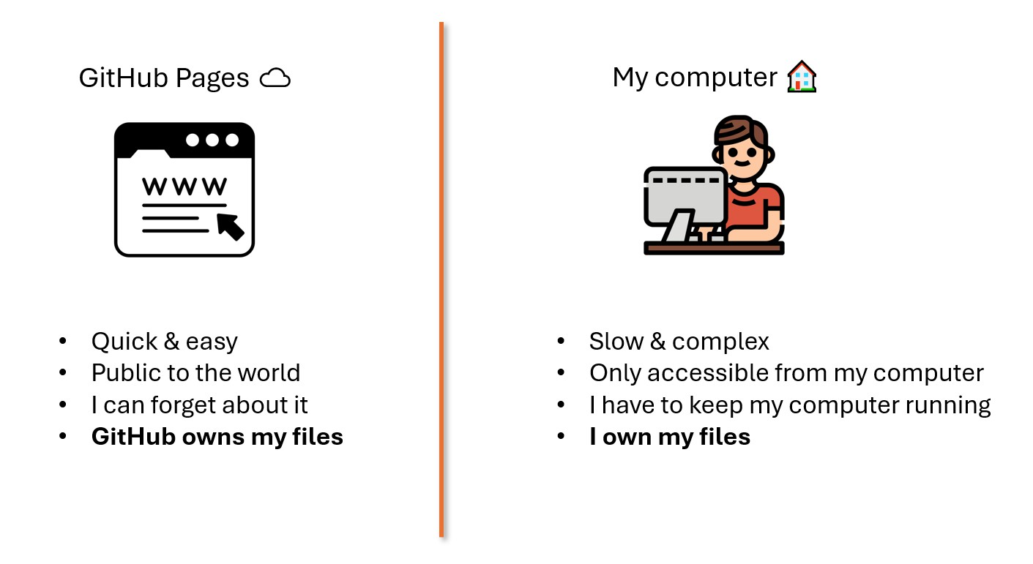
Website deployment
We explored GitHub as a PaaS to deploy our own website and compared it to a local deployment.
Figure 2: Differences between GitHub Pages and local deployment

Slide 5
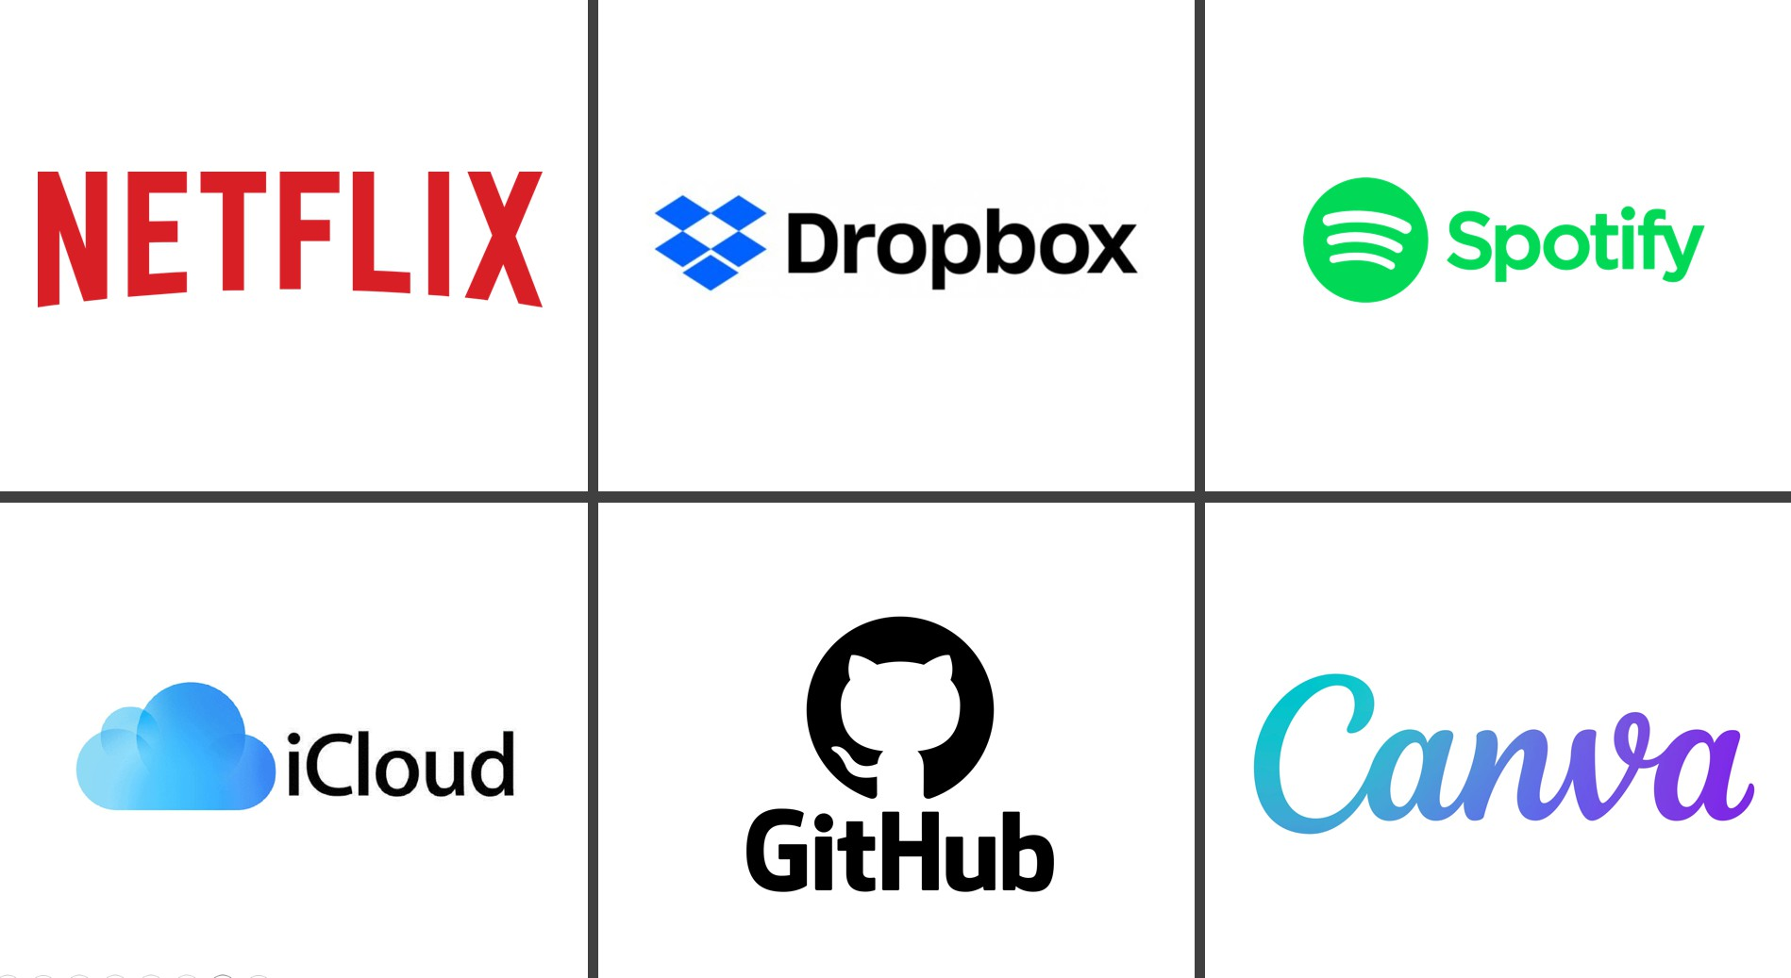
Cloud services everywhere
Cloud services go beyond just hosting websites. Examples include GitHub, Netflix, iCloud, and many more.
Figure 3: Popular cloud services

Slide 6
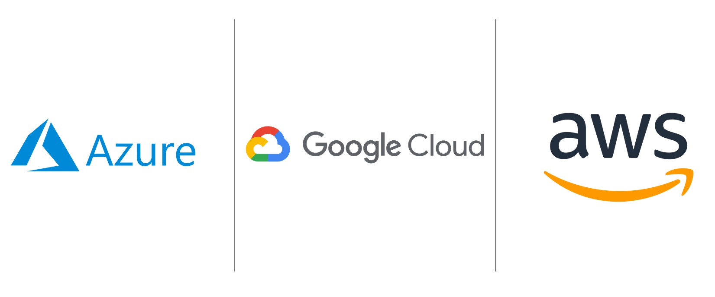
Cloud services everywhere
Beyond cloud services, we have the major cloud providers: Azure, Google Cloud Platform (GCP), and Amazon Web Services (AWS).
Figure 4: Major cloud providers

Slide 7
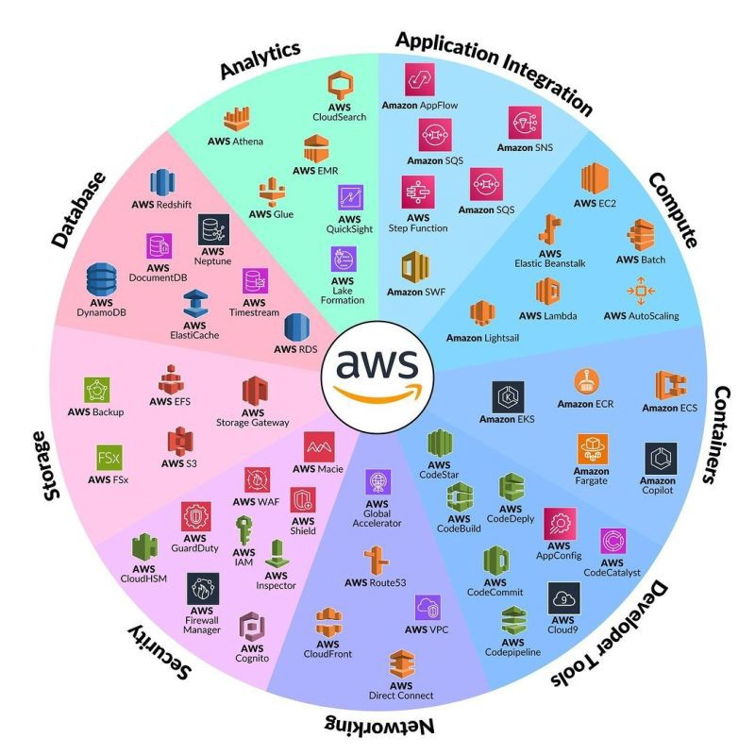
Amazon Web Services
We will focus on AWS in this session. AWS offers a variety of cloud services.
Figure 5: AWS services overview

Slide 8
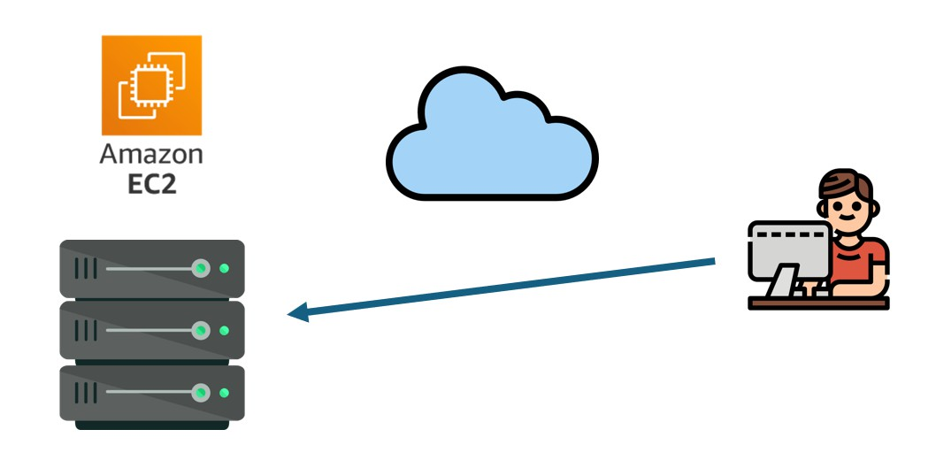
Amazon Web Services: EC2
Today, we will be using EC2 (Elastic Compute Cloud) to create and configure a virtual machine.
Figure 6: AWS EC2

Slide 9
Connecting to EC2

Slide 10
A remote terminal through SSH
What is a Terminal?
A terminal is an interface that allows users to interact with a computer using text commands. Unlike graphical user interfaces (GUIs), terminals allow direct communication with the operating system.

Slide 11
A remote terminal through SSH
What is a Terminal?
A terminal is an interface that allows users to interact with a computer using text commands. Unlike graphical user interfaces (GUIs), terminals allow direct communication with the operating system.
What is SSH?

Slide 12
A remote terminal through SSH
What is a Terminal?
A terminal is an interface that allows users to interact with a computer using text commands. Unlike graphical user interfaces (GUIs), terminals allow direct communication with the operating system.
What is SSH?
SSH (Secure Shell) is a protocol that allows secure remote access to machines over the internet. It enables users to execute commands on remote servers as if they were physically present.

Slide 13
A remote terminal through SSH
What is a Terminal?
A terminal is an interface that allows users to interact with a computer using text commands. Unlike graphical user interfaces (GUIs), terminals allow direct communication with the operating system.
What is SSH?
SSH (Secure Shell) is a protocol that allows secure remote access to machines over the internet. It enables users to execute commands on remote servers as if they were physically present.
When we connect to a remote machine through SSH, we are essentially opening a remote terminal on that machine.

Slide 14
How does SSH work?
SSH works with public and private keys to establish a secure connection. This eliminates the need for password-based authentication, enhancing security.

Slide 15
How does SSH work?
SSH works with public and private keys to establish a secure connection. This eliminates the need for password-based authentication, enhancing security.
Public and Private Keys
Public key: We are going to share this with the server.
Private key: This one is kept secret on our local machine.

Slide 16
How does SSH work?
SSH works with public and private keys to establish a secure connection. This eliminates the need for password-based authentication, enhancing security.
Public and Private Keys
Public key: We are going to share this with the server.
Private key: This one is kept secret on our local machine.
Key-Based Authentication
When we connect to a server using SSH, the server (the EC2 machine) checks if the public key matches the private key. If they match, access is granted.

Slide 17
What do you mean by client and server?
The Client-Server Model
The client-server model describes how computers communicate over a network.
The client (your local machine) accesses things or services on the server.
The server (the remote machine) is the one responsible for providing those services.

Slide 18
What do you mean by client and server?
The Client-Server Model
The client-server model describes how computers communicate over a network.
The client (your local machine) accesses things or services on the server.
The server (the remote machine) is the one responsible for providing those services.
Example: Watching a YouTube Video
When you watch a YouTube video, your computer (the client) sends a request to YouTube’s servers (the server) to stream the video.

Slide 19
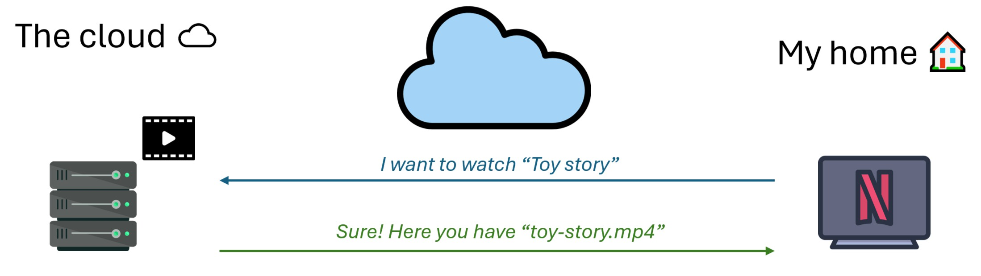
What do you mean by client and server?
Figure 7: Client-server model when watching Netflix

Slide 20
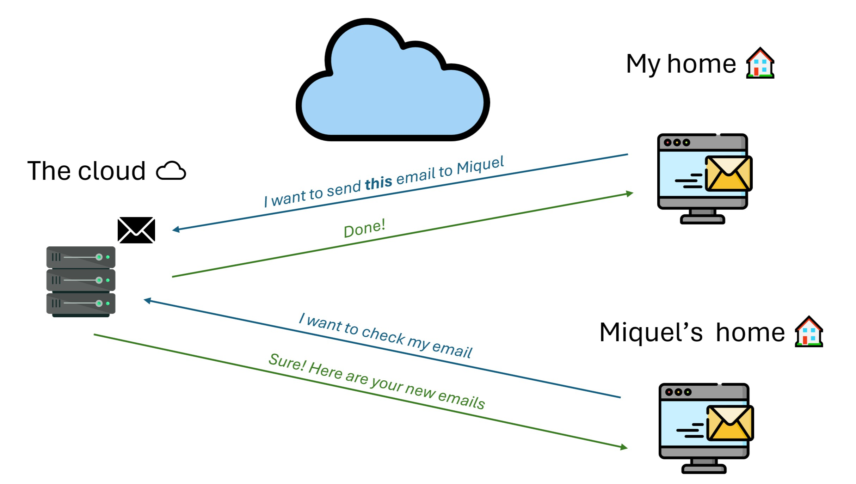
What do you mean by client and server?
Figure 8: Client-server model when sending emails

Slide 21
Why do I need to open ports?

Slide 22
Ports
What Are Ports?
Computers use ports to differentiate between different types of network services.

Slide 23
Ports
What Are Ports?
Computers use ports to differentiate between different types of network services. For example:
Port 22 → SSH (Remote Login)
Port 80 → HTTP (Web Traﬀic)
Port 443 → HTTPS (Secure Web Traﬀic)

Slide 24
Ports
What Are Ports?
Computers use ports to differentiate between different types of network services. For example:
Port 22 → SSH (Remote Login)
Port 80 → HTTP (Web Traﬀic)
Port 443 → HTTPS (Secure Web Traﬀic)
Hotel Analogy
Think of a hotel, where different rooms provide different services:
Room 22 is the reception (SSH access).
Room 80 is a public restaurant (HTTP web service).
Room 443 is a private lounge (HTTPS secure access).

Slide 25
Security groups
Configuring Security Groups
Security groups in AWS define which ports are open to the internet for which services.
By default, AWS blocks all incoming traﬀic.
You need to explicitly allow access to certain ports (e.g., SSH, HTTP).

Slide 26
Security groups
Configuring Security Groups
Security groups in AWS define which ports are open to the internet for which services.
By default, AWS blocks all incoming traﬀic.
You need to explicitly allow access to certain ports (e.g., SSH, HTTP).
What to configure on a Security Group
A security group is just a set of firewall rules. You can configure:
Inbound rules: Traﬀic coming into the server.
Outbound rules: Traﬀic going out of the server.

Slide 27
Security groups
Configuring Security Groups
Security groups in AWS define which ports are open to the internet for which services.
By default, AWS blocks all incoming traﬀic.
You need to explicitly allow access to certain ports (e.g., SSH, HTTP).
What to configure on a Security Group
A security group is just a set of firewall rules. You can configure:
Inbound rules: Traﬀic coming into the server.
Outbound rules: Traﬀic going out of the server.
Example: Opening Port 22 (SSH)
Type: SSH
Port Range: 22
Source: Your IP address or 0.0.0.0/0 (not recommended in production environments for security reasons).

Slide 28
Today’s Work on AWS

Slide 29
Goals for today
Today, we will:

Slide 30
Goals for today
Today, we will:
Create an EC2 instance.

Slide 31
Goals for today
Today, we will:
Create an EC2 instance.
Connect to it through SSH.

Slide 32
Goals for today
Today, we will:
Create an EC2 instance.
Connect to it through SSH.
Set up a Python environment.

Slide 33
Goals for today
Today, we will:
Create an EC2 instance.
Connect to it through SSH.
Set up a Python environment.
Configure a Jupyter Notebook server to access it from our local machine.

Slide 34
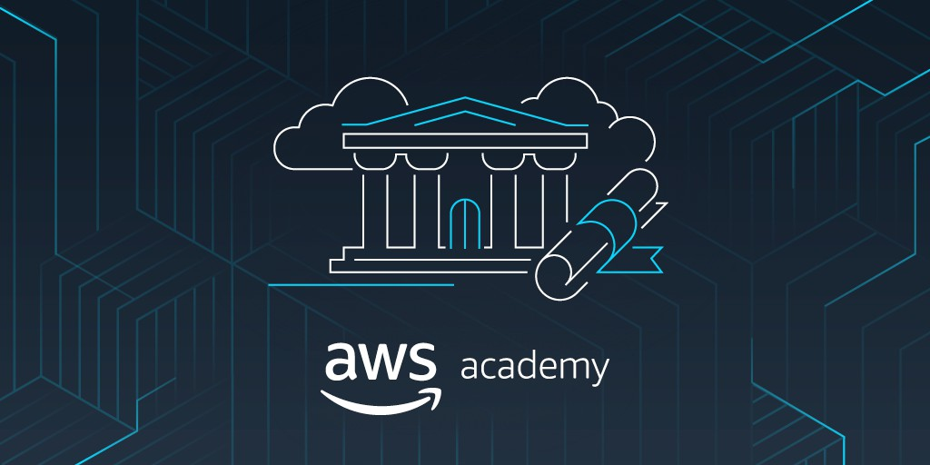
Introduction to AWS Academy
AWS Academy allows educators to provide students with access to real AWS services with a limited budget and restricted service access.
Figure 9: AWS Academy

Slide 35
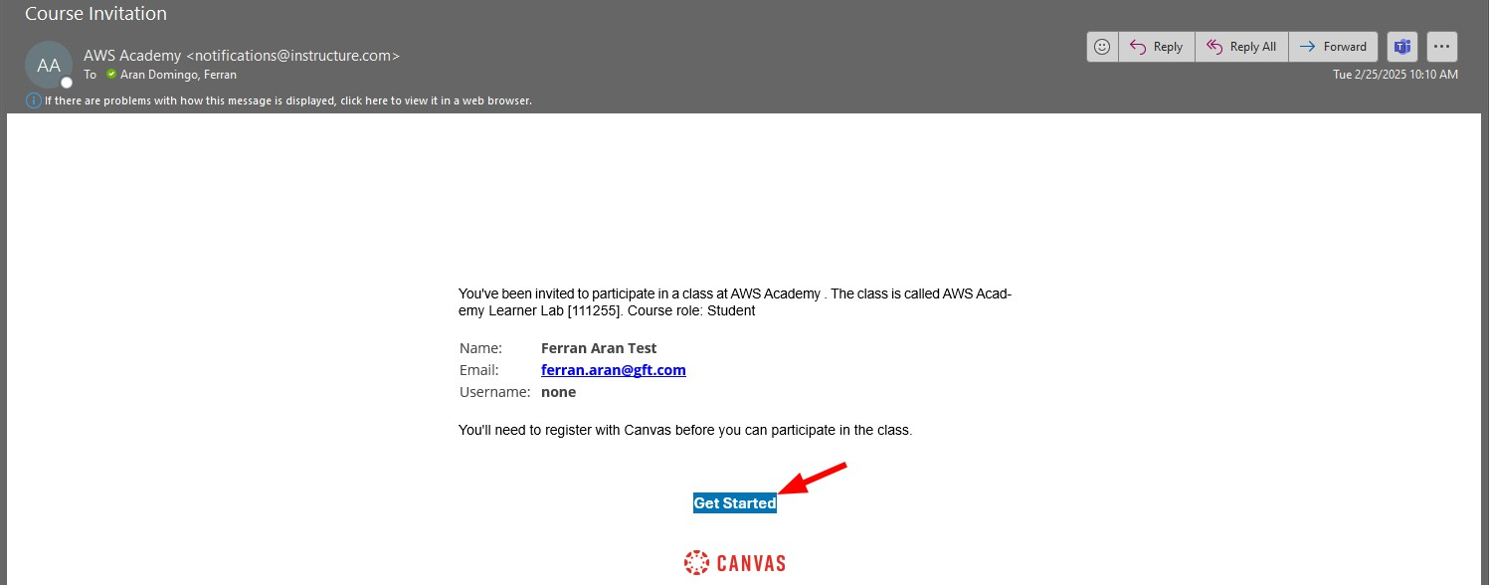
Activating your account
Figure 10: Accepting the invite

Slide 36
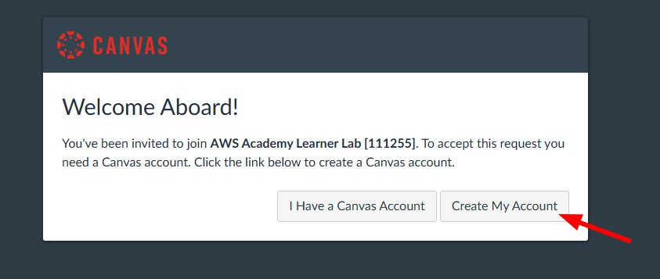
Activating your account
Figure 11: Creating your account

Slide 37
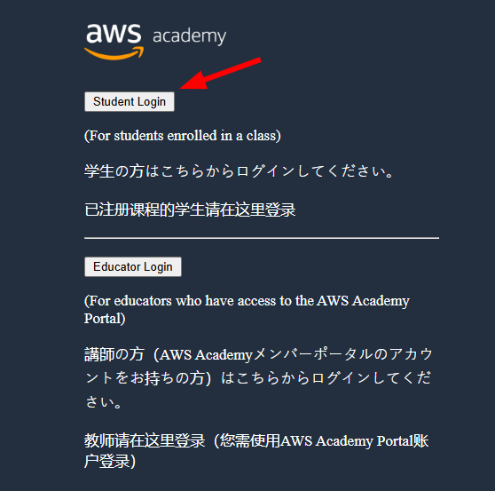
Logging in from now on
You’ll have to visit https://awsacademy.instructure.com/ and log in with your credentials as a student.
Figure 12: Login with your credentials

Slide 38
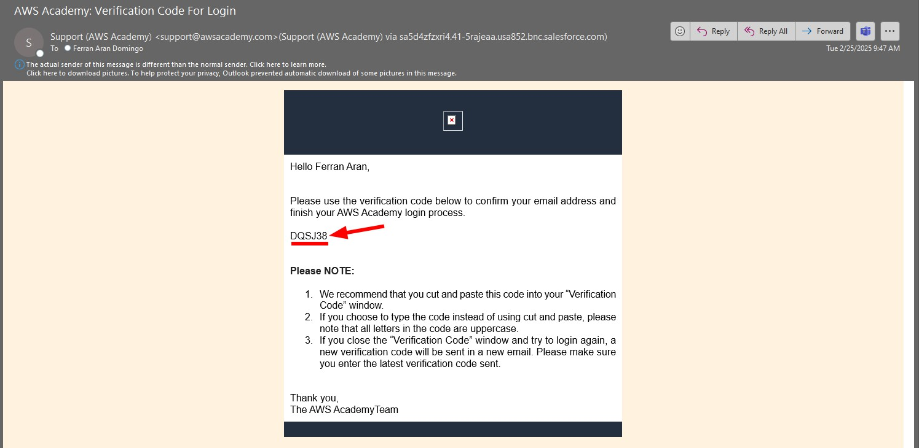
Logging in from now on
You will then receive an email with a verification code to complete the login process.
Figure 13: Enter verification code

Slide 39
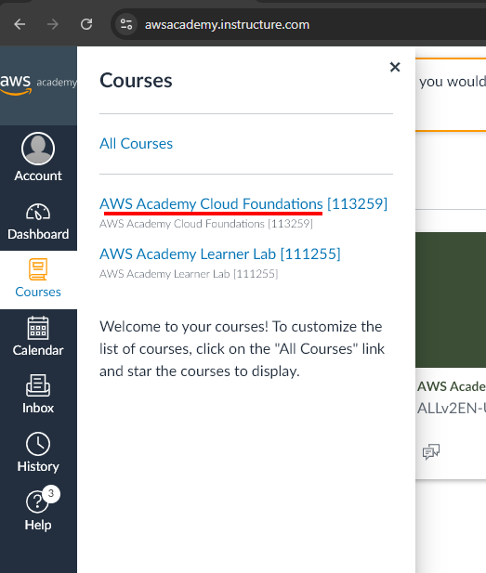
Available courses
You’ll have access to:
AWS Cloud Foundation Course (Theory-based learning).
AWS Learner Lab (Hands-on experience with AWS services).
Figure 14: Available courses

Slide 40
Available courses: AWS Cloud Foundation Course
All the students are invited to complete the AWS Cloud Foundations course. This course is available in the AWS Educate platform and it is a great introduction to the AWS services. The course is not mandatory, but it is highly recommended.
This introductory course is intended for students who seek an overall understanding of cloud computing concepts, independent of specific technical roles. It provides a detailed overview of cloud concepts, AWS core services, security, architecture, pricing, and support.

Slide 41
Available courses: AWS Learner Lab
We will be using Learner Lab to complete today’s tasks and future deliverables.
The Learner Lab is a hands-on environment where you can practice with real AWS services. You will have access to a limited set of services and a budget to use them.
It is a great opportunity to learn how to use AWS services in a real-world scenario since the dashboard is the same as the one used by professionals.
Getting into the Learner Lab Dashboard can be a bit tricky, so we will see which are the steps to follow.

Slide 42
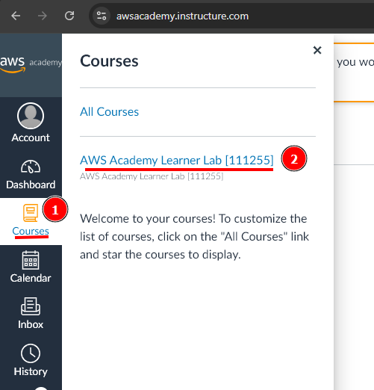
Accessing the Learner Lab
Figure 15: Choosing the learner lab course

Slide 43
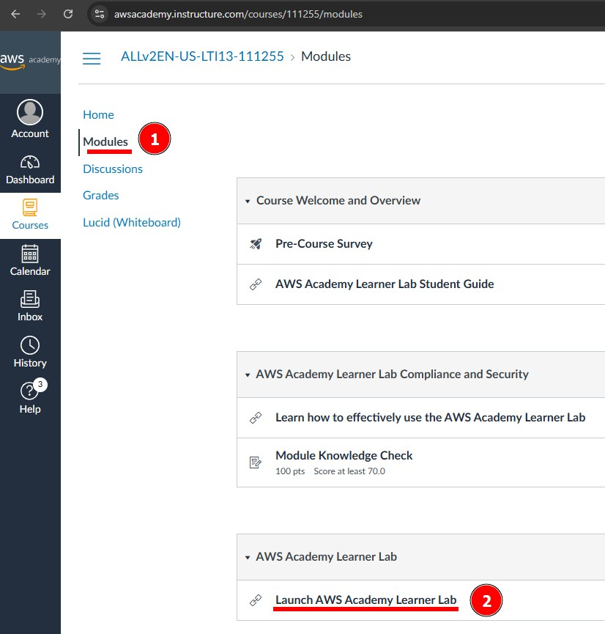
Accessing the Learner Lab
Figure 16: Choosing the learner lab module

Slide 44
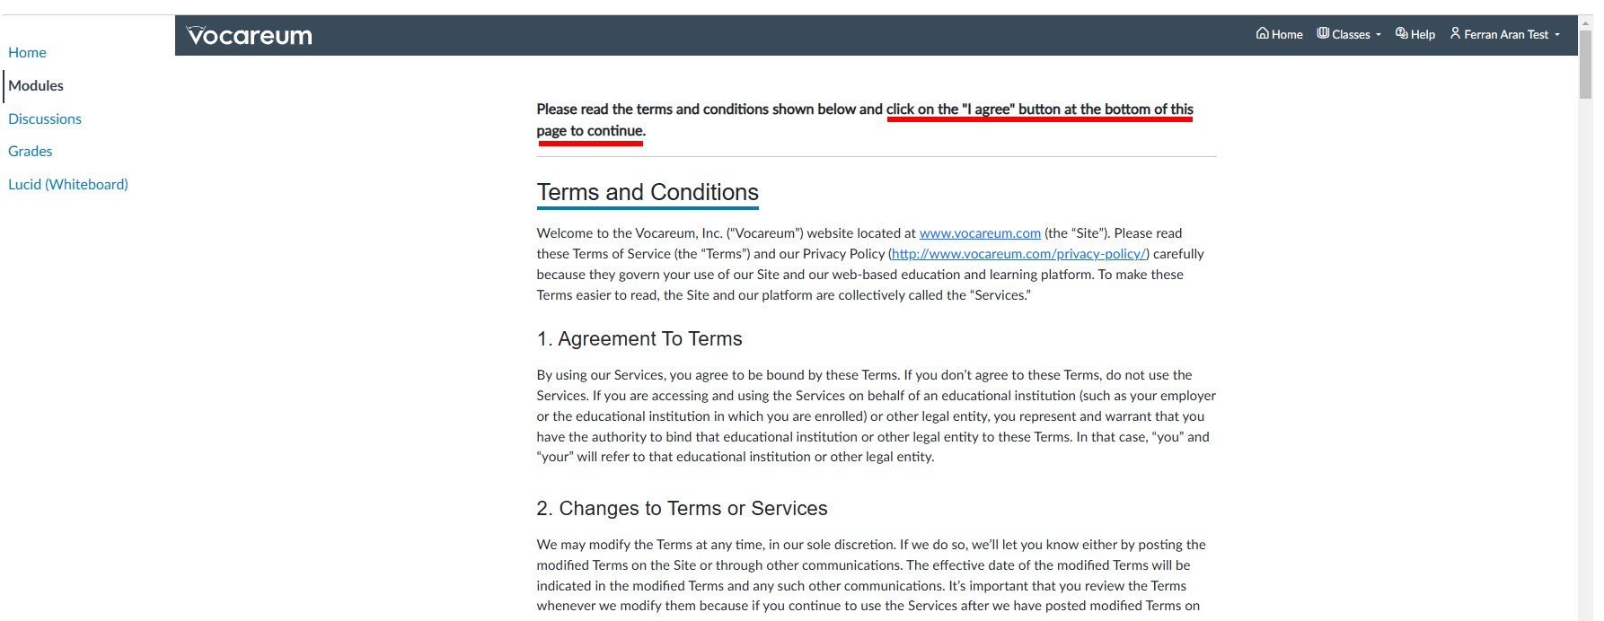
Accessing the Learner Lab
Figure 17: Scroll down and agree the terms and conditions

Slide 45
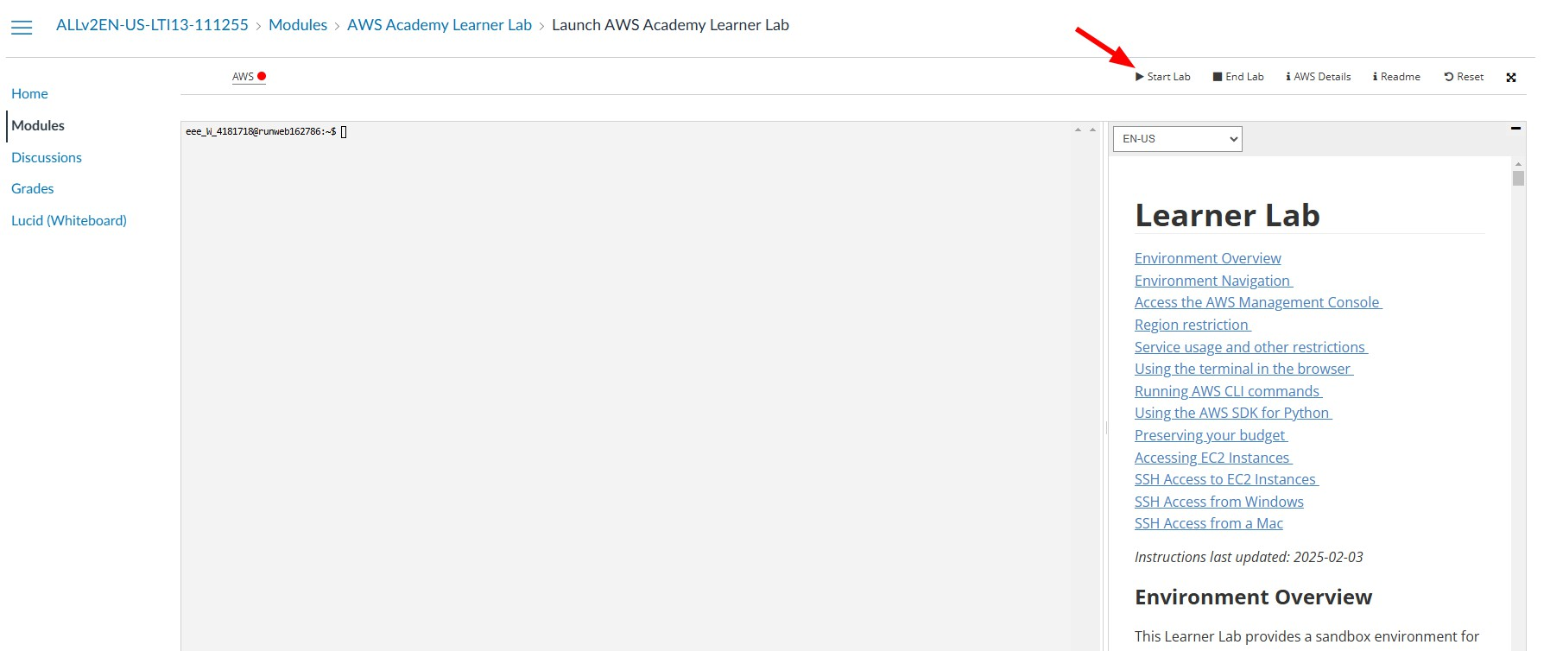
Accessing the Learner Lab
Figure 18: Click on ‘Start’

Slide 46
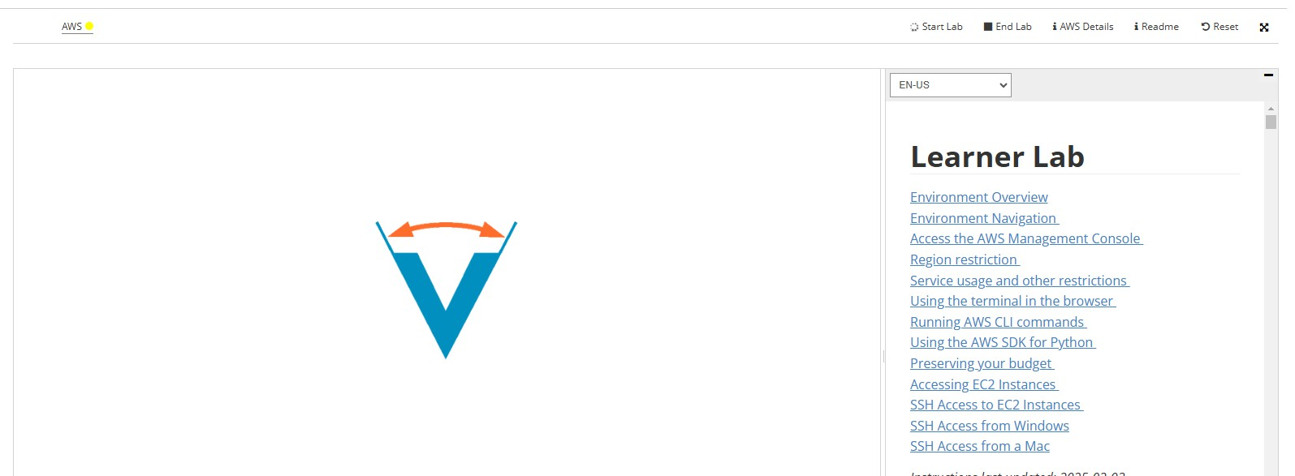
Accessing the Learner Lab
Figure 19: Wait for the environment to set up

Slide 47
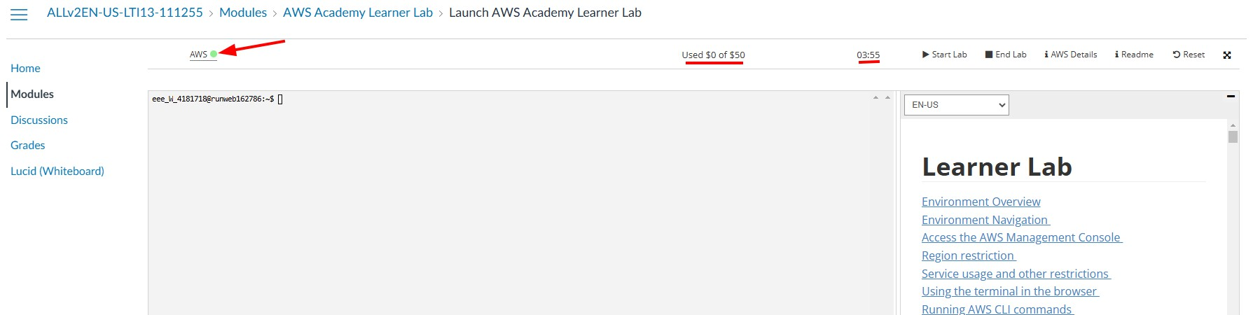
Accessing the Learner Lab
Figure 20: Once it is ready click on ‘AWS’

Slide 48
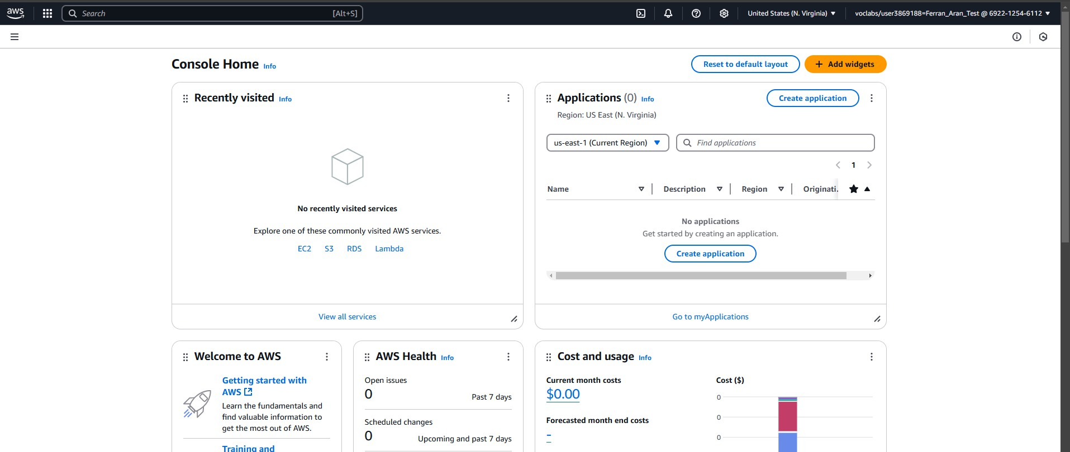
Accessing the Learner Lab
Figure 21: We are now presented with the dashboard

Slide 49
EC2 - Deploying a Jupyter Notebook

Slide 50
Creating an SSH Key Pair
Open a terminal or a powershell and type the following command:
mkdir .ssh
ssh-keygen -t rsa -f .ssh/aws-keypair
The first command might throw an error if the .ssh directory already exists. You can ignore it. The -t option specifies the type of key to create:
rsa
dsa
ecdsa
ed25519
The -f option specifies the filename of the key file.

Slide 51
Creating an SSH Key Pair
The command will prompt you to enter a file in which to save the key. The command will also prompt you to enter a passphrase. You can enter a passphrase or leave the passphrase empty. This command will create a public and a private key in the default location:
Public key: .ssh/aws-keypair.pub
Private key: .ssh/aws-keypair

Slide 52
Importing our generated key pair
AWS provides a key pair to connect to the EC2 instance. However, we can use our key pair.
Go to search and write Key Pairs.
Click on Key Pairs.
Click on Actions and then on Import Key Pair.
Fill the form with the following settings:
Name: aws-keypair
Browse and select the public key file we created before. (.ssh/aws-keypair.pub)
Another option is to paste the public key in the Public key contents field. Use command
cat .ssh/aws-keypair.pub to get the public key.
Import the key pair.

Slide 53
Creating an EC2 instance
Click on the Services and then on EC2.
Launch an instance.
Fill the form with the following settings:
Name: Jupyter Notebook
Image: Amazon Linux 2 AMI (HVM) - SSD Volume Type
Architecture: 64-bit (x86)
Type: t2.micro
Key pair: use the key pair created before. (aws-keypair)
Network: default VPC

Slide 54
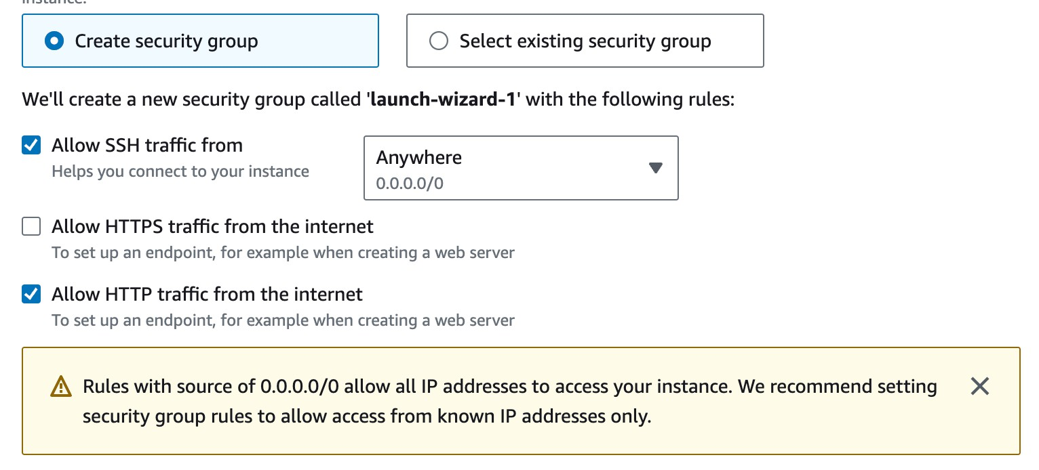
Security Group
This instance requires a security group that allows traﬀic on port 22 (SSH) and port 80 (HTTP).
SSH is used to connect and manage the instance.
HTTP is used to access the Jupyter Notebook from the browser.
Mark the checkbox to create a new security group and fill the form with the following settings:
Allow SSH from anywhere
Allow HTTP traﬀic from the internet

Slide 55
Connecting to the instance
Open a terminal (mac,linux) or a powershell (windows).
Use the following command to connect to the instance. Replace the public DNS with the public DNS of your instance.
aws-keypair is the name of to the private key file. We need to introduce the full path to the file (for example .ssh/aws-keypair).
ec2-user is the default user for the Amazon Linux EC2 machine. Don’t worry about it.
ec2-3-87-76-117.compute-1.amazonaws.com is the public DNS of the instance. This is going to change everytime you restart your lab and each EC2 will have its own. So everytime you want to connect to the instance you will have to get the public DNS from the AWS console.
ssh -i .ssh/aws-keypair ec2-user@ec2-3-87-76-117.compute-1.amazonaws.com Are you sure you want to continue connecting (yes/no/[fingerprint])? yes

Slide 56
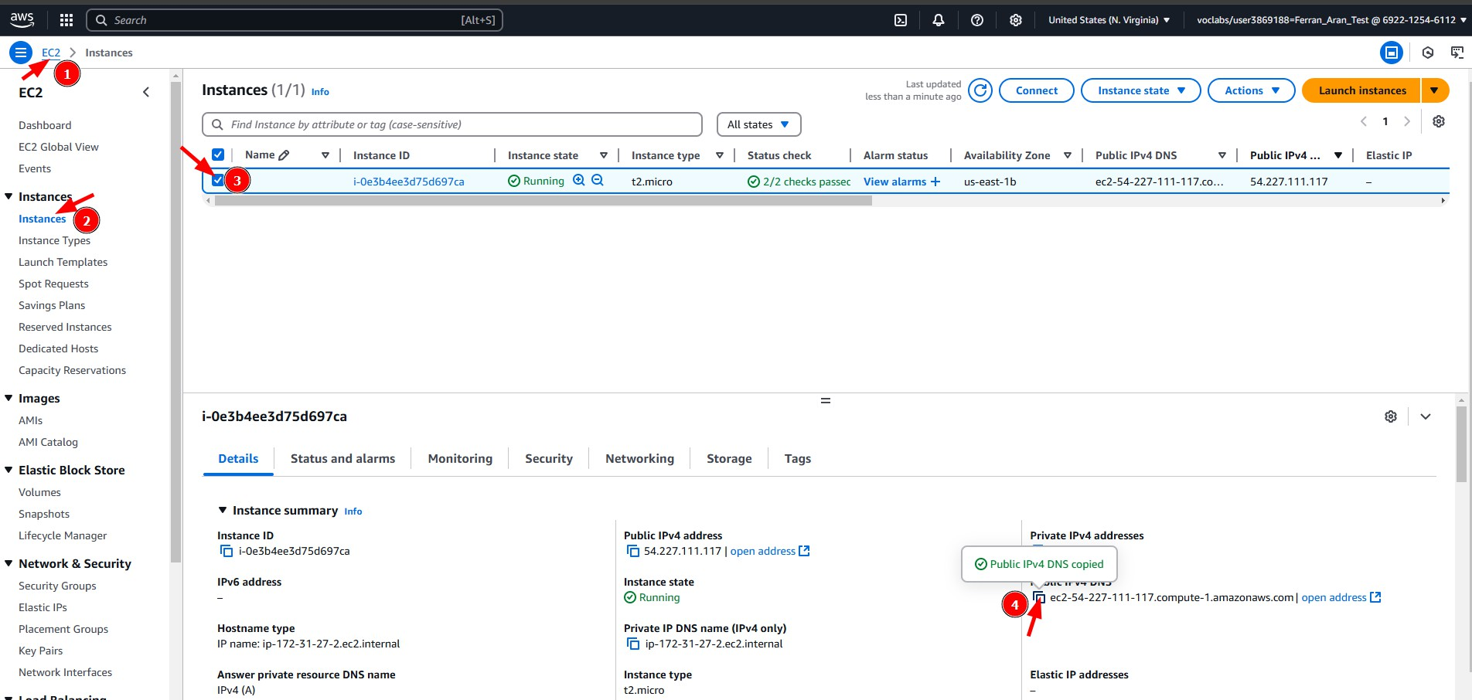
Connecting to the instance
Figure 22: Getting the public DNS of your EC2 instance

Slide 57
Managing Python environments with uv

Slide 58
Why use uv?
Python version management: Easily switch between different versions.

Slide 59
Why use uv?
Python version management: Easily switch between different versions.
Dependency isolation: Keep projects independent.

Slide 60
Why use uv?
Python version management: Easily switch between different versions.
Dependency isolation: Keep projects independent.
Reproducibility: Ensures that dependencies remain consistent.

Slide 61
Installing uv
For more information about uv I encourage you to read the oﬀicial documentation.
To install it, run the following on your EC2 instance:
curl -LsSf https://astral.sh/uv/install.sh | sh
If it worked, you should see the following message on your terminal:
everything's installed!

Slide 62
Creating two example uv Projects
We will create two environments with different Python versions and dependencies.
Project 1: Python 3.8 + Jupyter
mkdir project1 cd project1
uv venv --seed --python 3.8 .project1-venv source .project1-venv/bin/activate
pip install jupyter deactivate
cd ..

Slide 63
Creating two example uv Projects
We will create two environments with different Python versions and dependencies.
Project 1: Python 3.8 + Jupyter Project 2: Python 3.10 + Jupyter + Pandas
mkdir project1 cd project1
uv venv --seed --python 3.8 .project1-venv source .project1-venv/bin/activate
pip install jupyter deactivate
cd ..
mkdir project2
cd project2
uv venv --seed --python 3.10 .project2-venv
source .project2-venv/bin/activate pip install jupyter pandas deactivate
cd ..

Slide 64
Working with the environments
When I want to work with project1:
cd project1
source .project1-venv/bin/activate
Now I when I run python, it will use the Python 3.8 version and when using pip, it will install packages in the project1 environment.
Installed packages will be stored and the next time I activate the environment, they will be available.
python --version
# Output
Python 3.8.20
When I am finished working with project1:
deactivate cd ..

Slide 65
Working with the environments
When I want to work with project2:
cd project2
source .project2-venv/bin/activate
Now I when I run python, it will use the Python 3.10 version and when using pip, it will install packages in the project2 environment.
When I am finished working with project2:
deactivate cd ..

Slide 66
Running Jupyter Notebook (I)
We will first need one of the environments activated. For example, project1.
cd project1
source .project1-venv/bin/activate

Slide 67
Running Jupyter Notebook (I)
We can now run the Jupyter Notebook server. There are two ways to run the server:
Running on localhost (default): Not accessible from the internet.
jupyter notebook
Running on the public IP: Accessible from the internet.
jupyter notebook --ip=? --port=?
ip:
0.0.0.0 (default): Listen on all IP addresses.
Public IP: Obtain the public IP from the instance and use it.
port:
8888 (default): The default port for the Jupyter Notebook. This port is not opened by the security group.

Slide 68
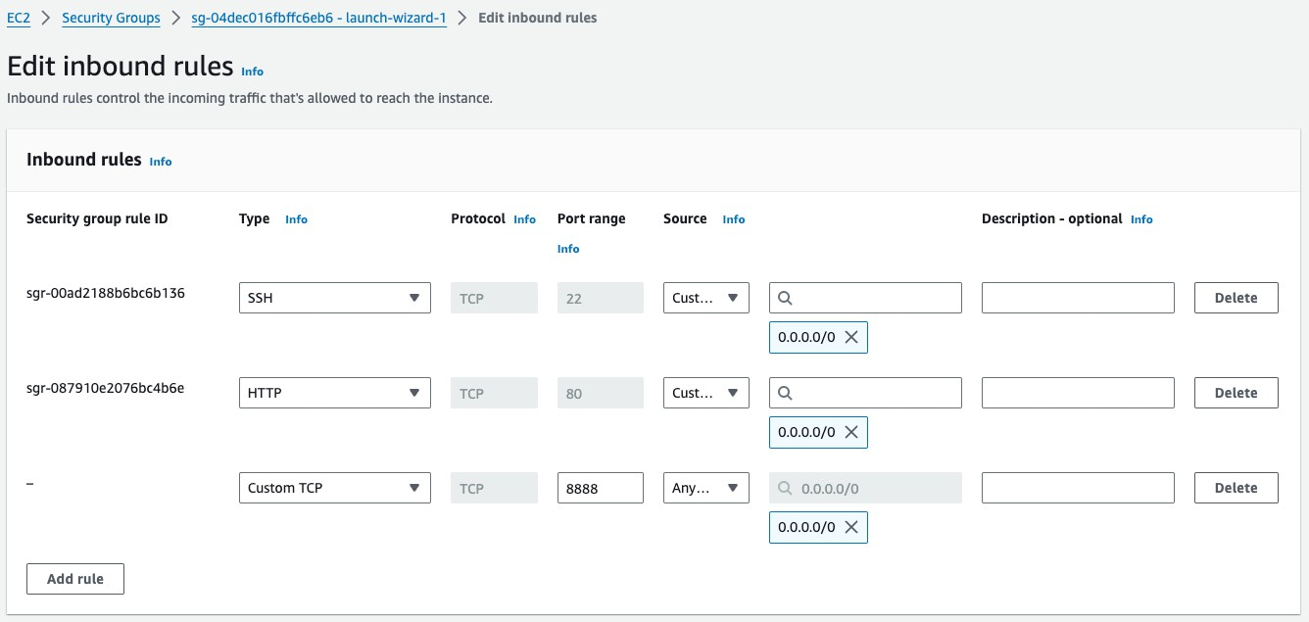
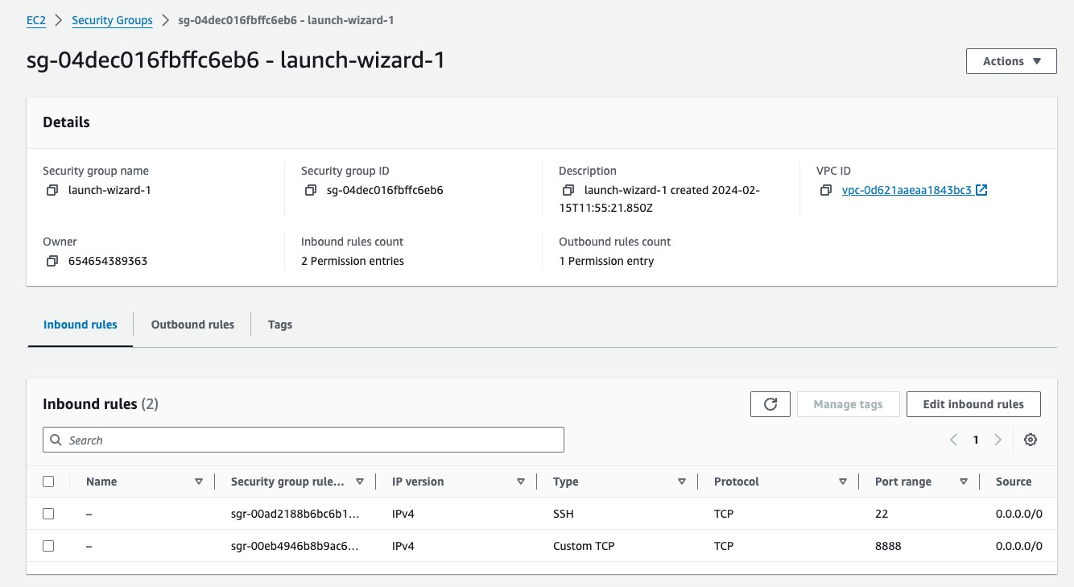
Opening the port 8888
Search for Security Groups (EC2). Click on launch-wizard-1.
Edit the inbound rules and add a new rule with the following settings:
Type: Custom TCP
Port Range: 8888
Source: Anywhere (0.0.0.0/0)
Delete the old rule for HTTP (port 80).
Save the changes.

Slide 69
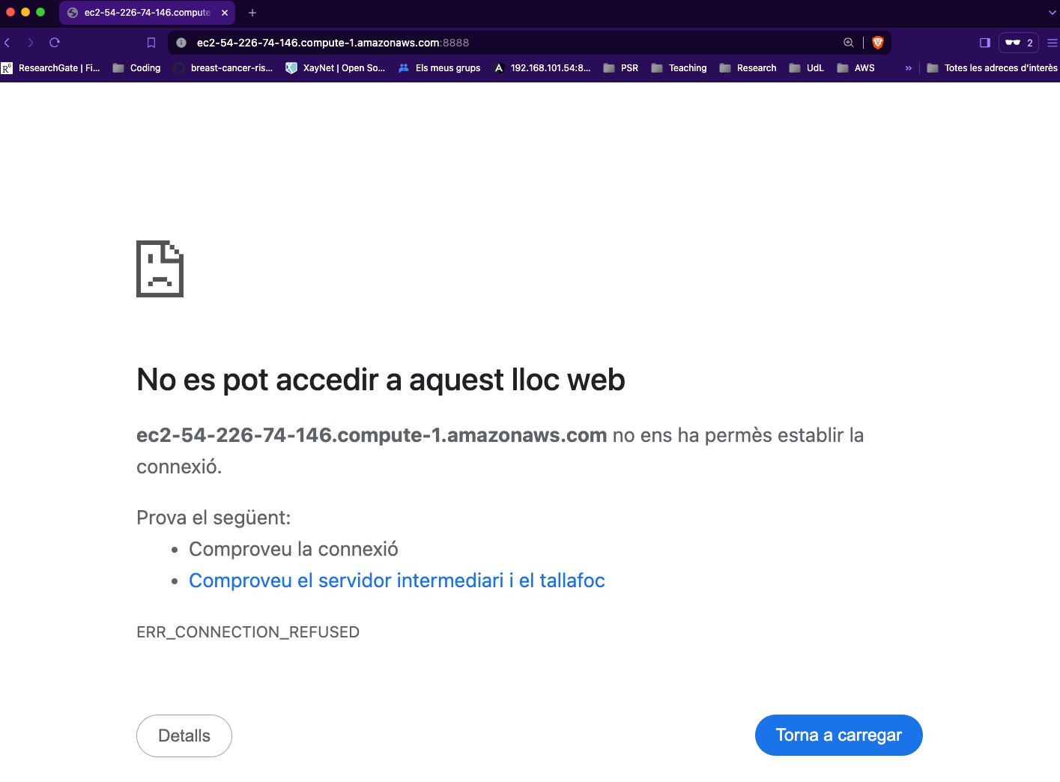
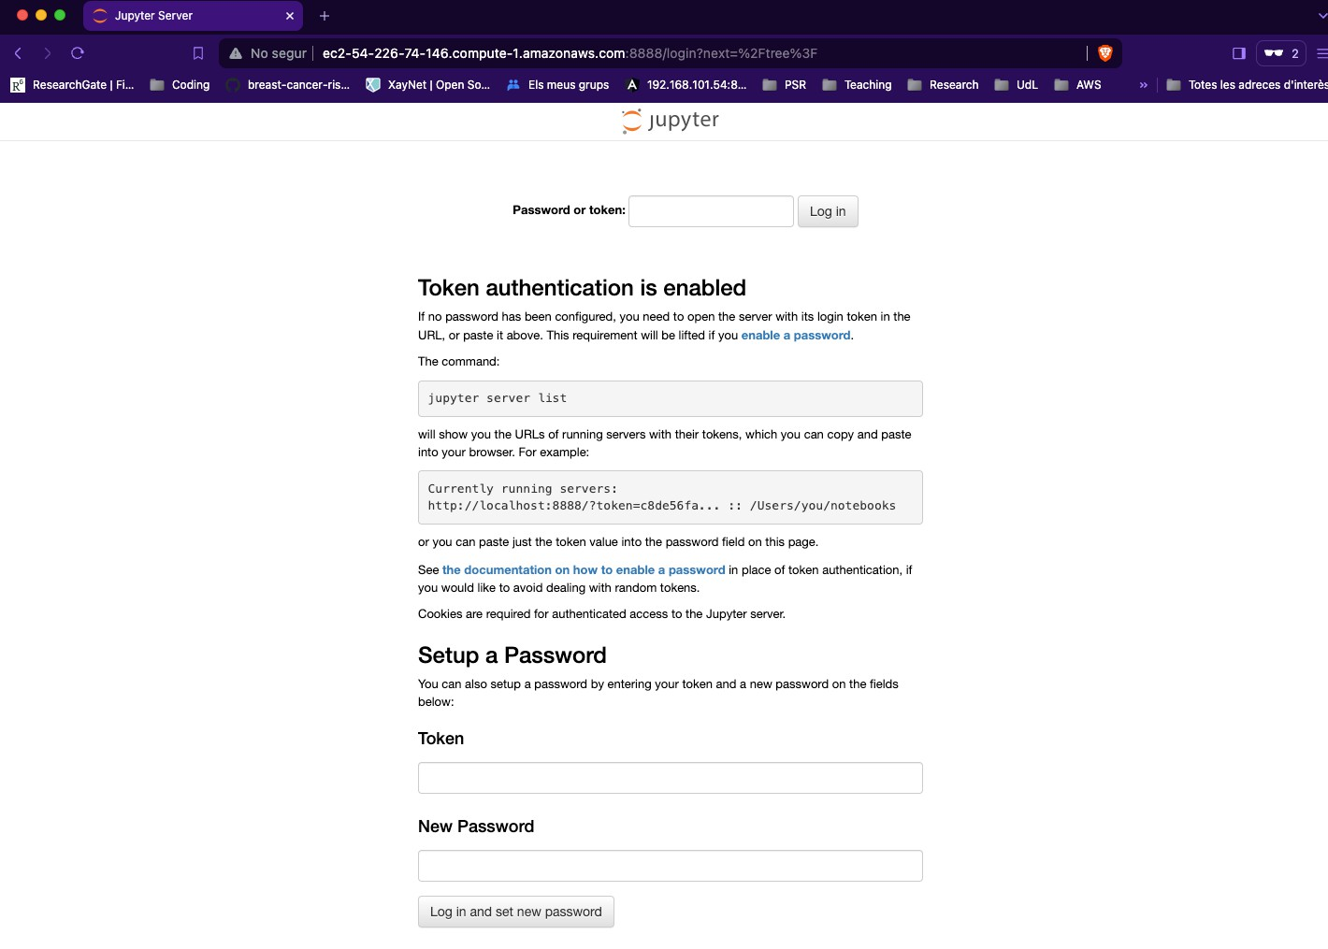
Running Jupyter Notebook (II)
jupyter notebook --ip=0.0.0.0 --port=8888
# In the browser
http://ec2-3-87-76-117.compute-1.amazonaws.com:8888
Before running the command
After running the command

Slide 70
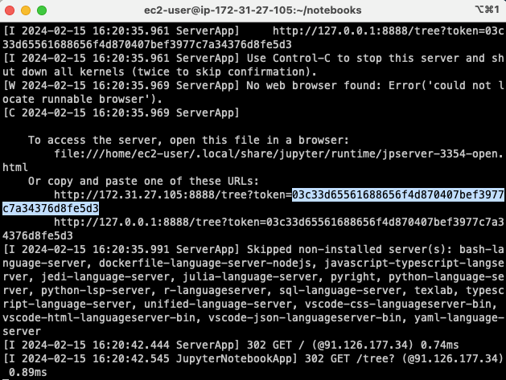
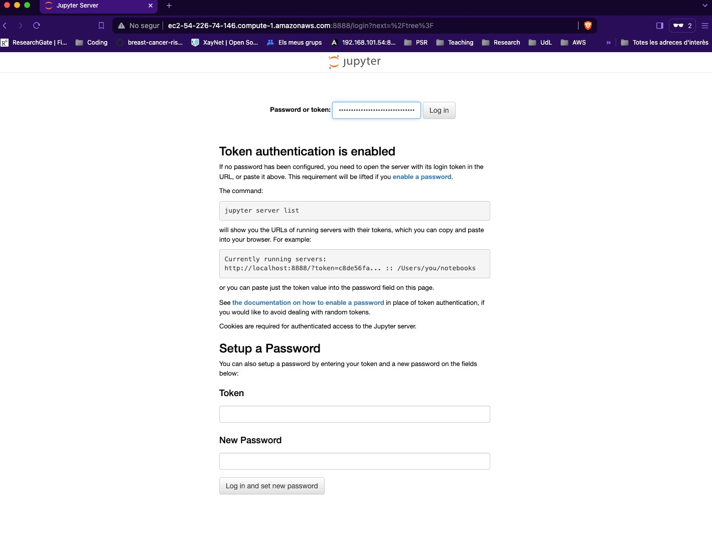
Accessing the Jupyter Notebook
Copy the token from the terminal. Then, log in to the Jupyter Notebook from the browser. (If you have trouble copying the token, instead of Ctrl+C, use Ctrl+Shift+C on the terminal).

Slide 71
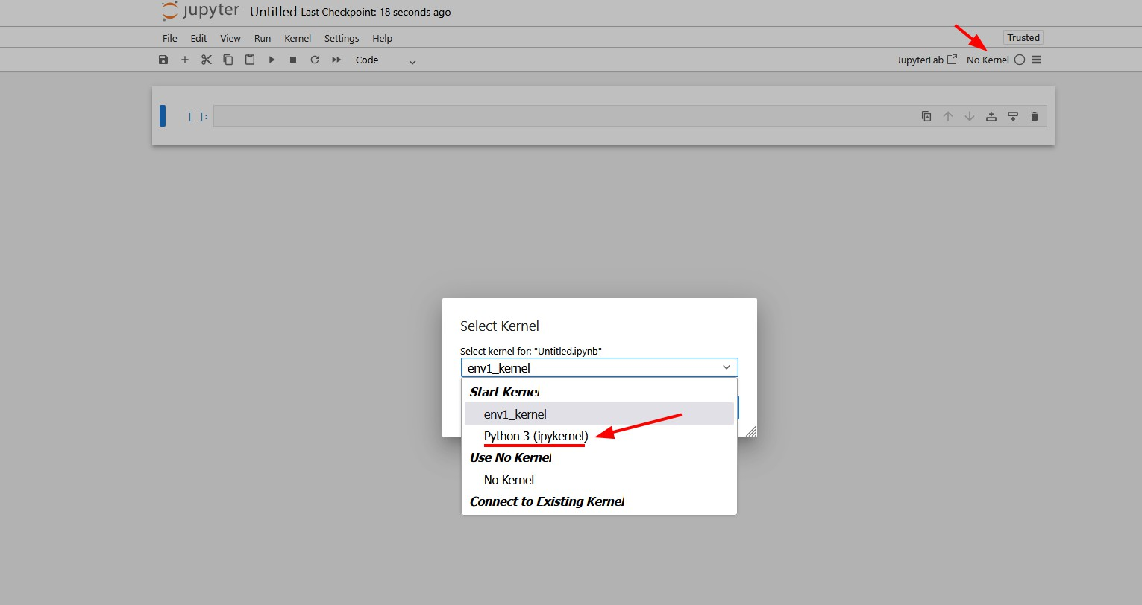
Accessing the Jupyter Notebook
Once on the Jupyter Notebook, to create a new notebook do the following:
Click on File → New → Notebook.
You will be prompted to choose the kernel. Be careful, the default one is going to fail, you have to change it to Python 3 as shown below. If the only available option is Python 3 that is fine, leave it as it is (we saw during class that in my demonstration there was only one option).
Figure 23: How to choose the right kernel

Slide 72
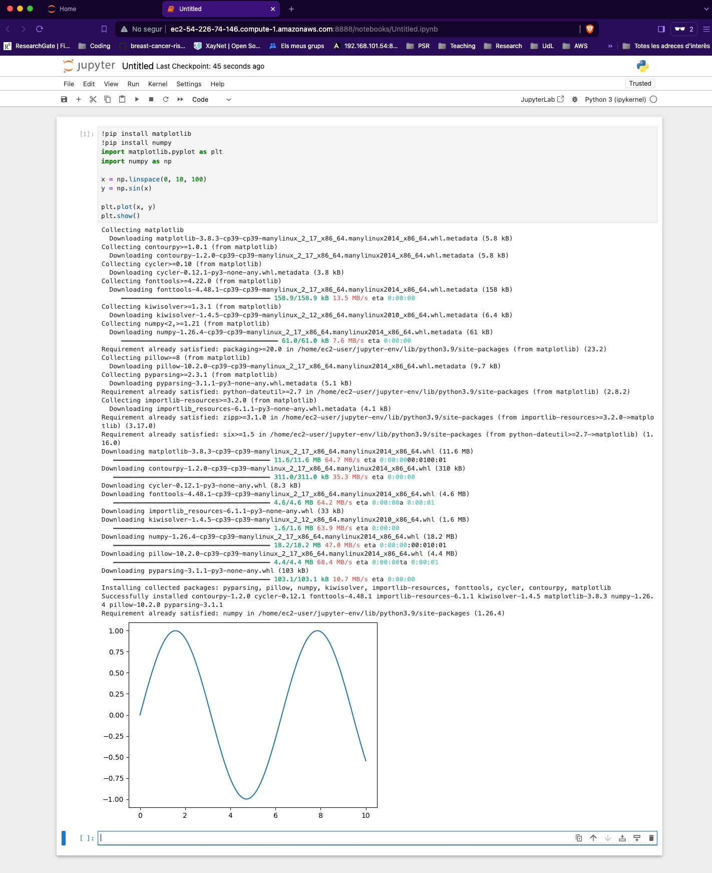
Running python code in the notebook
Click on New and then on Python 3. Write the following code and run it.
!pip install matplotlib
!pip install numpy
import matplotlib.pyplot as plt
import numpy as np
x = np.linspace(0, 10, 100) y = np.sin(x)
plt.plot(x, y) plt.show()

Slide 73
Commands to remember
uv venv --seed --python 3.8 .project1-venv: Create a Python 3.8 environment named
.project1-venv.
source .project1-venv/bin/activate: Activate the .project1-venv environment. (You have to be on the same directory as the environment).
pip install jupyter: Install Jupyter Notebook in the current environment. (You have to activate the environment first).
pip install pandas: Install Pandas in the current environment.
pip install numpy==1.21.0 : Install a specific version of a package. (In this case, Numpy 1.21.0).
jupyter notebook --port=8888 --ip=0.0.0.0 : Run Jupyter Notebook on port 8888 and listen on all IP addresses.
deactivate: Deactivate the current environment.

Slide 74
Commands to remember
mkdir project1 : Create a directory named project1 .
cd project1 : Move to the project1 directory.
cd ..: Move to the parent directory.
cat .ssh/aws-keypair.pub: Show the contents of file located at .ssh/aws-keypair.pub.

Slide 75
Conclusion

Slide 76
1. We have learned the about services in AWS, specifically EC2.
RECAP: Summary of the session

Slide 77
RECAP: Summary of the session
We have learned the about services in AWS, specifically EC2.
We have learned how to deploy a Jupyter Notebook in EC2 and manage Python environments with uv.

Slide 78
RECAP: Summary of the session
We have learned the about services in AWS, specifically EC2.
We have learned how to deploy a Jupyter Notebook in EC2 and manage Python environments with uv.
We have learned about security groups, key pairs, and how to connect to the instance using SSH.

Slide 79
Why use Jupyter on the Cloud?
Example Use Cases
Large Datasets: If a dataset is too big for a local machine (e.g., 1000GB), cloud storage and compute power are essential.

Slide 80
Why use Jupyter on the Cloud?
Example Use Cases
Large Datasets: If a dataset is too big for a local machine (e.g., 1000GB), cloud storage and compute power are essential.
High Computational Requirements: Some models require GPUs or high-memory machines, which can be rented via AWS.

Slide 81
Why use Jupyter on the Cloud?
Example Use Cases
Large Datasets: If a dataset is too big for a local machine (e.g., 1000GB), cloud storage and compute power are essential.
High Computational Requirements: Some models require GPUs or high-memory machines, which can be rented via AWS.
Collaboration: I can give access to others to my Jupyter Notebook with the same environment and data.

